Slide 1
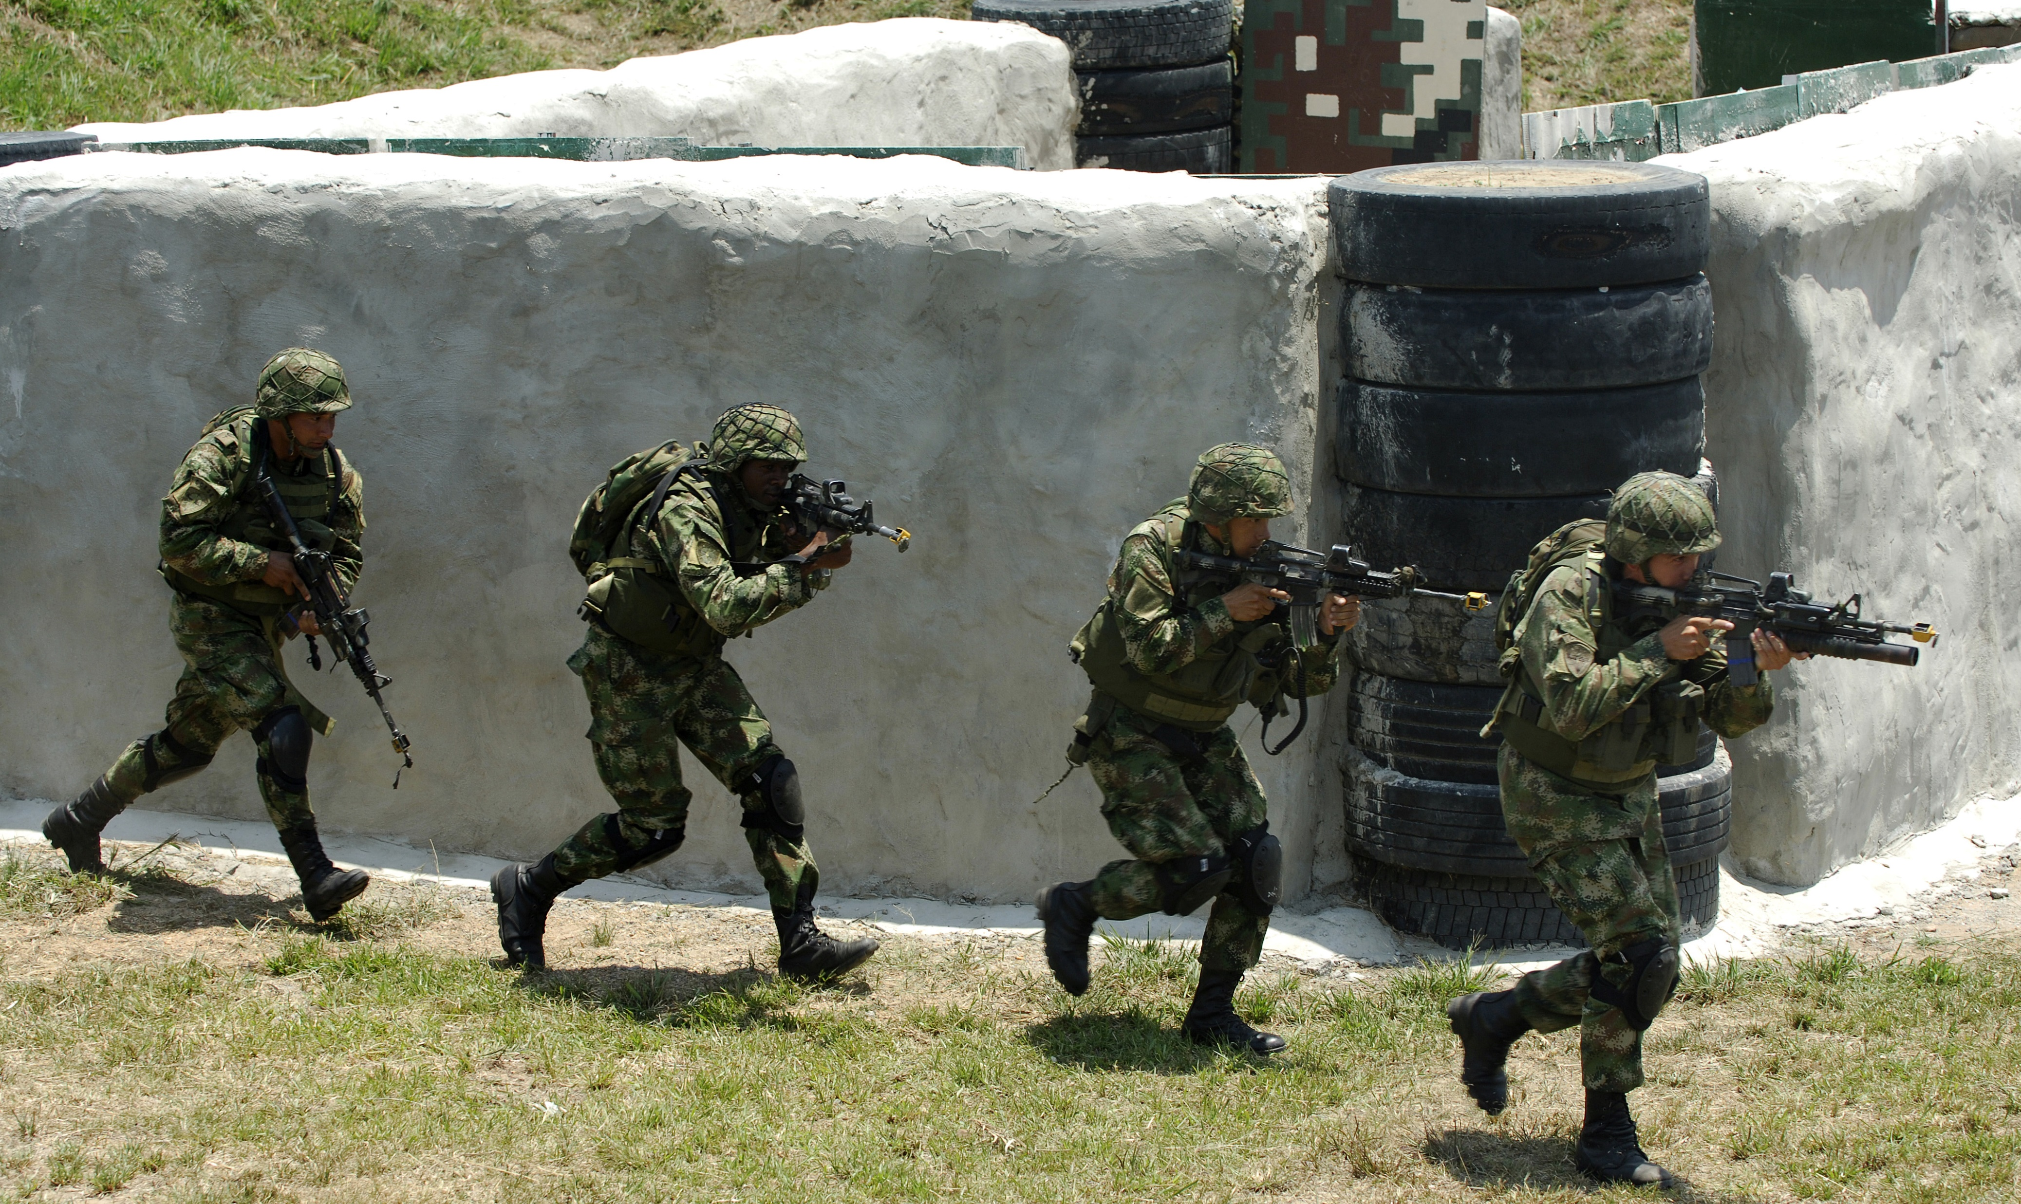
Casos Colombia
Downloaded at:
3/24/2023 7:47:55 PM UTC

Slide 2
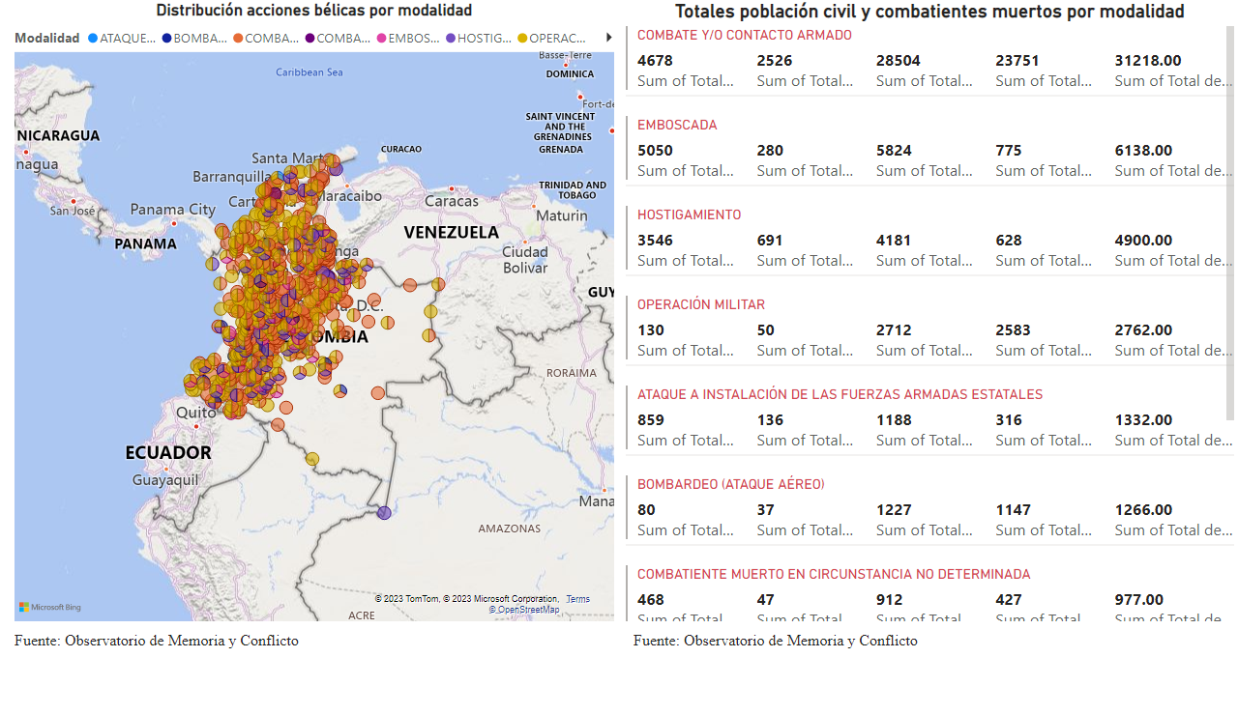
Página 1
Notes:
Distribución acciones bélicas por modalidad
In this picture, we can the distrubution of war actions over Colombia. Here, the most are distribuited in the West, Center and Norht part. Combate/Contacto Armado represents the most the war actions.
Totales población civil y combatientes muertos por modalidad
At this case, we can see the number of total deaths by modality . As shown the most deaths belong to Combate/Contacto Armado with 31218 deaths.

